Slide 1
Movie Revenue Prediction using youtube trailer Data
Jeff Russell
Student #: 500168083
February 29, 2019
CKME 136 – Ryerson University

Slide 2
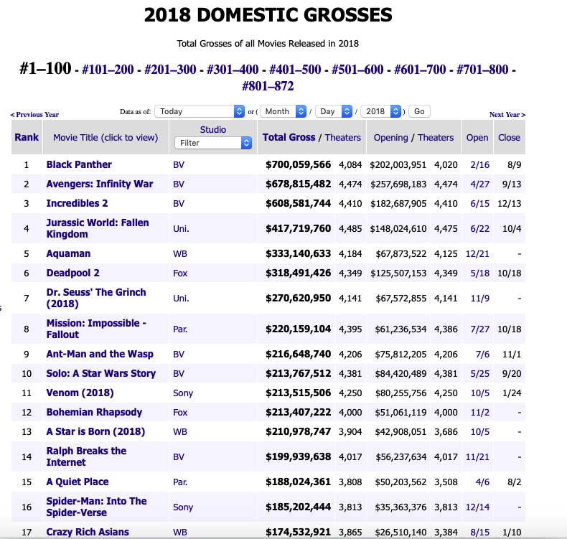
Objective

Slide 3
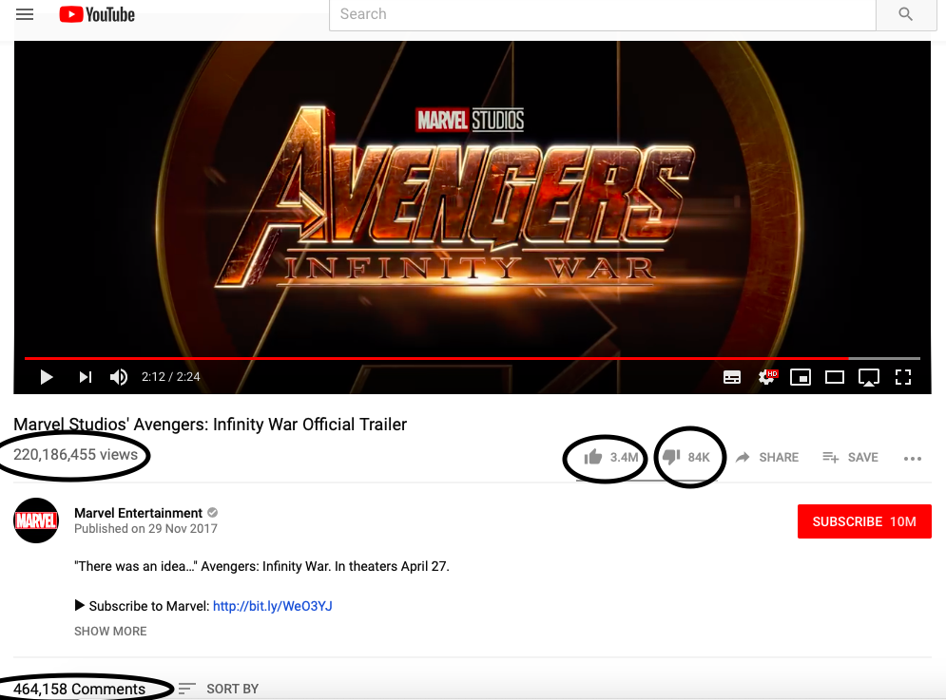
Objective
The goal of the project is to predict the domestic (North America) total box office revenue of a movie after it’s opening weekend, based on the performance of it’s official YouTube movie trailer
Implications:
Data collected from the YouTube movie trailer can provide useful insights into predicting a movie’s total box office.
Maximize revenue
Studio’s and marketers can create more “efficient” trailers to create buzz
Theater owners can plan for which movies to keep playing

Slide 4
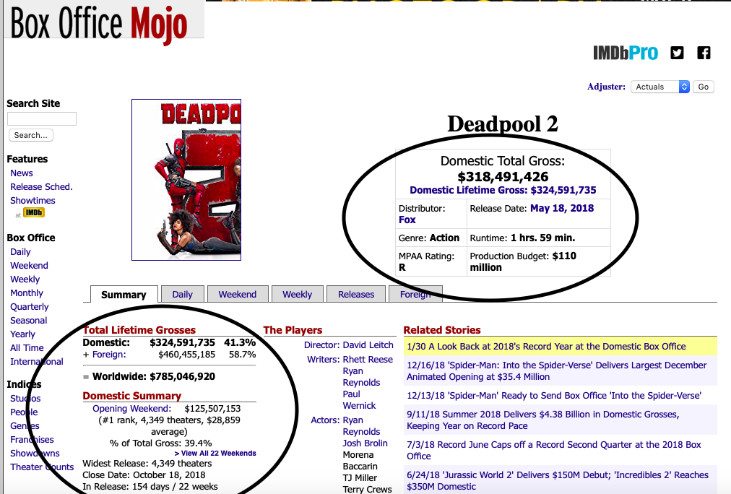
Dataset
Self curated
Sources are YouTube for movie trailer data and Box Office Mojo for movie related data using Tuber R package and webscraper package RVest
Data collected for movies that were released in the years 2012 to 2018

Slide 5
Dataset
The final dataset, after cleaning, has 15 variables and 869 observations with the following structure:
Variable Name | Type | Description
OpeningTheaters | int | number of screens the movie played on its opening weekend date
ViewCount | int | total number of comments for the YouTube movie trailer
LikeCount | int | total number of likes for the YouTube movie trailer
DislikeCount | int | total number of dis-likes for the YouTube movie trailer
LikeDislikeRatio | int | ratio of likes to dislikes (= LikeCount/DislikeCount)
CommentCount | int | total number of comments for the YouTube movie trailer
positiveWordsBL | int | total number of positive words in comments section of YouTube trailer video using Bing-Liu lexicon
negativeWordsBL | int | total number of negative words in comments section of YoutTube movie trailer using Bing-Liu lexicon
netSentimentBL | int | positive – negative words using Bing-Liu lexicon
scoreAbsoluteAFINN | int | total score using AFINN lexicon which assigns words with a score that runs between -5 and 5, with negative scores indicating negative sentiment and positive scores indicating positive sentiment. Total was calculated by summing the score of each word
budget | int | budget of the movie in $
OpeningWeekendGross | int | box office revenue of the movie during its first weekend of release
genre | factor | genre of the movie
mpaaRating | factor | censor rating that the Motion Picture Association of America assigns to a movie
TotalGross | integer | target variable -- total box office revenue of a movie during its entire theatrical release.

Slide 6
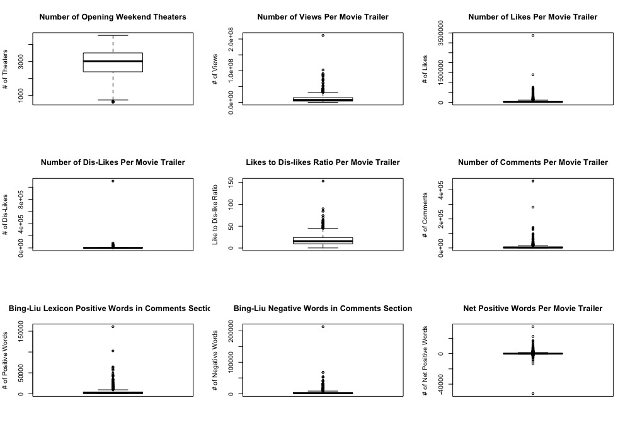
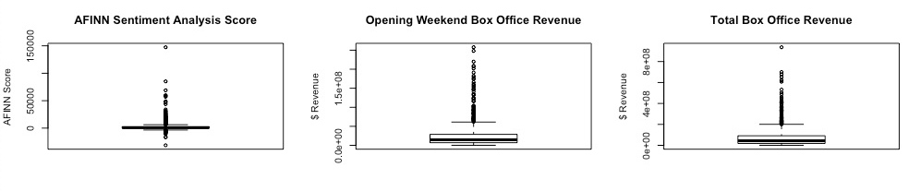
Descriptive Analysis
Outliers are observations of mega-block buster movies
Notes:
The outliers are observations of the “mega-blockbuster” movies. These are movies that gross very high revenue and account for most of the overall market box office revenue, even though they represent a small portion of the total number of movies released. Thus, outliers will not be removed, since they are legitimate observations.

Slide 7
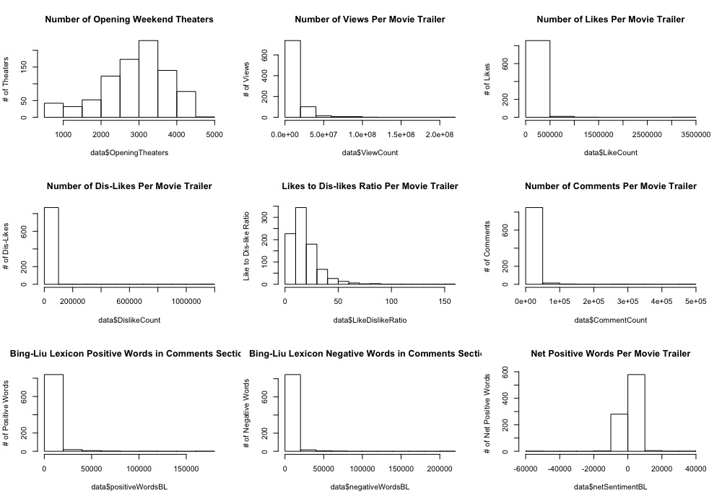
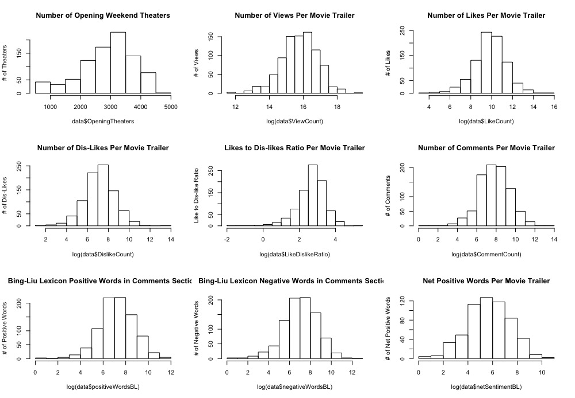
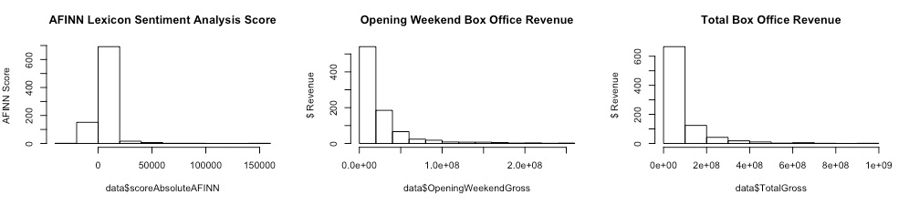
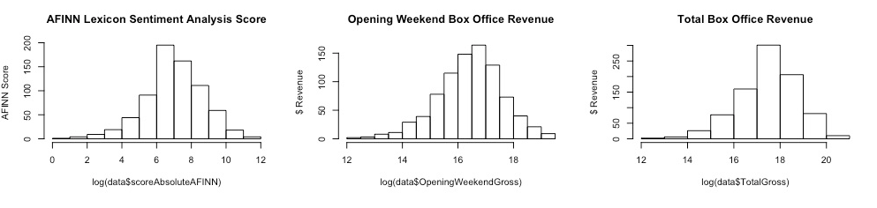
Descriptive Analysis
Right skewed data –negatively impact prediction results for linear regression model
Histogram of features
Log transformation of features
Notes:
The outliers are observations of the “mega-blockbuster” movies. These are movies that gross very high revenue and account for most of the overall market box office revenue, even though they represent a small portion of the total number of movies released. Thus, outliers will not be removed, since they are legitimate observations.

Slide 8
Feature Selection
Checking for correlation
Variance Inflation Factor
VIF greater than 5 is considered to have high collinearity
Feature | VIF
OpeningTheaters | 2.2
log(ViewCount) | 2.0
log(LikeCount) | 50.0
log(DislikeCount) | 48.2
log(LikeDislikeRatio) | 25.7
log(CommentCount) | 7.2
log(positiveWordsBL) | 6.7
log(negativeWordsBL) | 6.5
netSentimentBL | 1.4
scoreAbsoluteAFINN | 1.5
log(budget) | 1.7
log(OpeningWeekendGross) | 2.1
genre | 1.1
mpaaRating | 1.2
Feature | VIF
OpeningTheaters | 2.2
log(ViewCount) | 1.9
log(LikeCount) | 2.4
log(positiveWordsBL) | 2.1
netSentimentBL | 1.4
scoreAbsoluteAFINN | 1.5
log(budget) | 1.7
log(OpeningWeekendGross) | 2.1
genre | 1.1
mpaaRating | 1.1
✂

Slide 9
Model Selection
Linear Regression
Support Vector Regression
Regression Tree
Model’s forecast numeric data
Support Vector Regression and Regression Tree can model non-parametric data – does not depend on normal distribution for dependent and independent variables
70/30 training/test split was used for all models

Slide 10
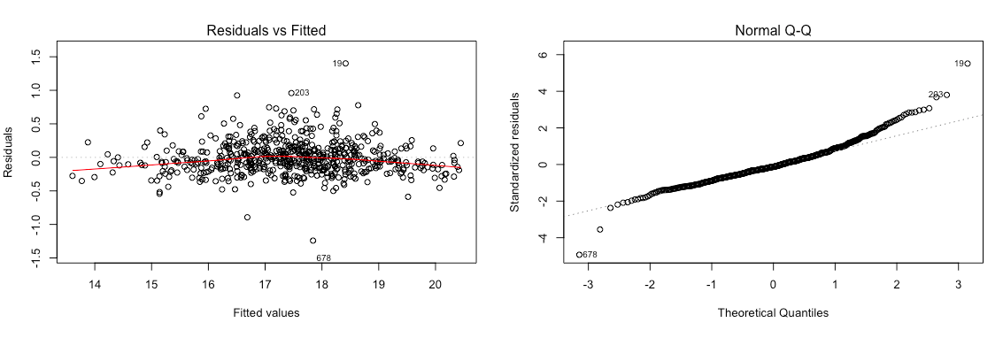
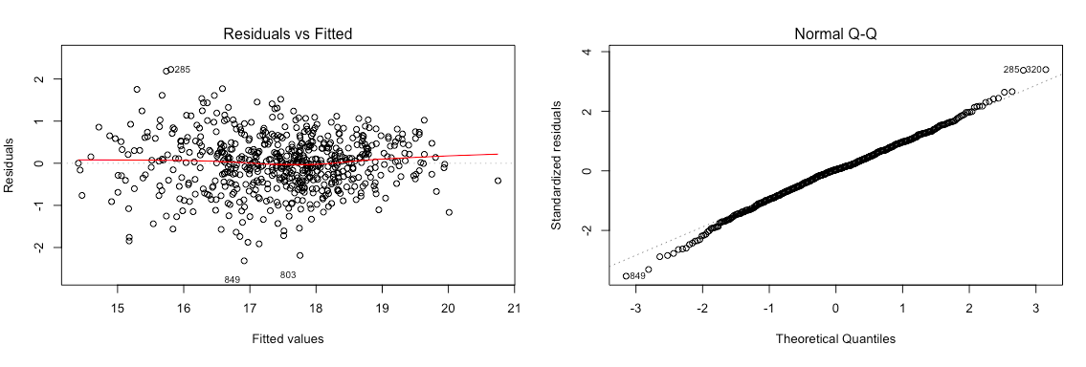
Model Selection
Linear Regression
First pass using the extracted features from the results of the VIF test produced a very high adjusted R-squared (0.9598) – indication of errors
Residual clustered around center
QQ Plot shows evidence of non-normal distribution
Removed OpeningWeekendGross – subset of TotalGross
Second pass produced a more realistic adjust R-squared (0.7229). This became the starting point for building the most accurate model.
Residuals more spread out and residuals in QQ Plot close to line
Normality assumed

Slide 11
Model Selection
Linear Regression
Model Description | R- Squared | Adjusted R-Square | RMSE | MAE
Linear regression with all variables extracted from VIF test and excluding OpeningWeekendGross | 0.7312 | 0.7229 | 53,154,569 | 29,783942
Linear regression using forward and backward step | 0.732 | 0.7238 | 53,981,526 | 30,035,497
Linear regression using backward step | 0.732 | 0.7238 | 53,981,526 | 30,035,497
Linear regression using forward step | 0.732 | 0.7229 | 53,154,569 | 29,783,942
Linear regression removing “genre” variable | 0.717 | 0.7146 | 55,099,417 | 30,251,839
Linear regression removing “mpaaRating variable | 0.7174 | 0.7141 | 55,068,904 | 30,077,898
Backward and forward step reduction proved to be the best model with adjusted R-square of 0.7238
OpeningTheaters, log(ViewCount), log(positveWordsBL), log(budget), genreComedy, genreDrama, genreHorror, mpaaRating all significant variables with p-value <0.05

Slide 12
Model Selection
Support Vector Regression
Model with feature reduction (from VIF test)
Kernel | Epsilon | Cost | RMSE | MAE
Linear | 0.1 | 1 | 23,919,228 | 14,144,839
Linear | 0.1 | 10 | 23,976,432 | 14,157,638
Linear | 0.1 | 100 | 23,972,757 | 14,165,560
Linear | 0.1 | 200 | 23,964,321 | 14,164,409
Linear | 0.1 | 250 | 23,966,377 | 14,162,629
Linear | 0.1 | 300 | 23,970,212 | 14,161,348
Linear | 0.1 | 1000 | 24,985,612 | 14,584,813
Radial | 0.1 | 1 | 26,732,553 | 14,941,701
Radial | 0.1 | 10 | 26,326,294 | 14,756,409
Radial | 0.1 | 100 | 27,766,890 | 16,961,866
Radial | 0.1 | 1000 | 40,184,958 | 22,8324,34
The SVR algorithm depends on kernel functions (linear, polynomial, sigmoid, radial) and it also allows a non-linear model to be built without transforming the variables.
The kernels transforms the dataset from non-linear space to linear space and allows the SVR model to find a fit and then map back to the original non – linear space.
Optimal model is where cost/error function produces the lowest error (using RMSE)

Slide 13
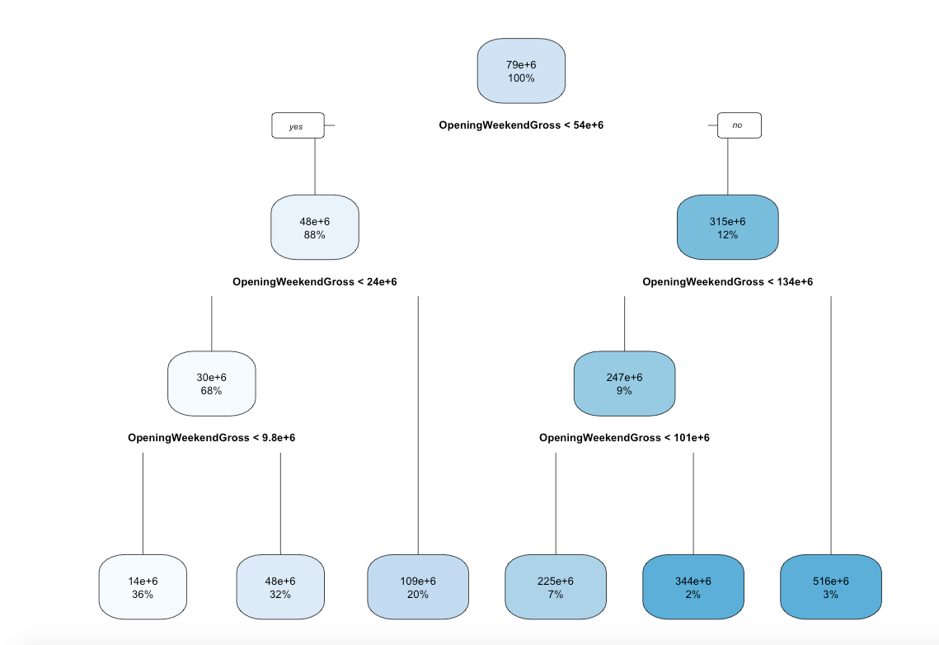
Model Selection
Regression Tree
Model Description | RMSE | MAE
All variables | 35,207,020 | 21,890,060
Variables extracted from VIF test | 35,207,020 | 21,890,060
All variables extracted from VIF test with OpeningWeekendGross removed | 69,609,712 | 38,470,326
Cross Validation (xerror)
 | CP | nsplit | rel error | xerror | xstd
1 | 0.63133 | 0 | 1 | 1.00389 | 0.15877
2 | 0.13601 | 1 | 0.36867 | 0.38573 | 0.06948
3 | 0.08330 | 2 | 0.23266 | 0.26191 | 0.03787
4 | 0.01715 | 3 | 0.14936 | 0.17126 | 0.03358
5 | 0.01625 | 4 | 0.13221 | 0.15126 | 0.03281
6 | 0.01000 | 5 | 0.11596 | 0.13870 | 0.03271
Optimal cross-validated pruned tree model is a tree with six nodes
Regression tree algorithm chosen as best, only uses one predictor, OpeningWeekendGross.
Notes:
The following table shows the RMSE and MAE scores for different models of regression trees. All models were ran using the “rpart” package in R with default settings. The goal is to find the model that minimizes error RMSE.
Applying the regression tree algorithm to the initial set of features/variables in the dataset results in an RMSE of 35,207,020. Next, running the regression on the feature set extracted from the VIF test produced the exact same results as the full feature set. This implies that both models are using the same number of nodes, which are automatically pruned in the rpart package. For both models, OpeningWeekendGross was the most important variable. Given that OpeningWeekendGross is a subset of the target variable, TotalGross, OpeningWeekendGross was removed from the feature set and the regression ran for a third time. The removal of OpeningWeekendGross decreased performance of the model, with RMSE increasing substantially to 69,609,712.

Slide 14
Model Selection
Regression Tree – Random Forest
Model Description | RMSE | MAE
Random Forest default | 29,145,319 | 16,820,431
Random Forest Tuned | 24,414,600 | 13,596,727
Applying random forest significantly improved the performance of the model over the regression tree model, reducing RMSE to 29,453,319.
Tuning the model, using 10-Fold cross validation, further increased performance, reducing RMSE to 24,414,600
Notes:
The following table shows the RMSE and MAE scores for different models of regression trees. All models were ran using the “rpart” package in R with default settings. The goal is to find the model that minimizes error RMSE.
Applying the regression tree algorithm to the initial set of features/variables in the dataset results in an RMSE of 35,207,020. Next, running the regression on the feature set extracted from the VIF test produced the exact same results as the full feature set. This implies that both models are using the same number of nodes, which are automatically pruned in the rpart package. For both models, OpeningWeekendGross was the most important variable. Given that OpeningWeekendGross is a subset of the target variable, TotalGross, OpeningWeekendGross was removed from the feature set and the regression ran for a third time. The removal of OpeningWeekendGross decreased performance of the model, with RMSE increasing substantially to 69,609,712.

Slide 15
Conclusion
Model Description | RMSE | MAE
Support Vector Regression | 23,919,228 | 14,144,839
Linear Regression | 53,981,526 | 30,035,497
Random Forest Tuned | 24,414,600 | 13,596,727
SVM model with linear kernel and cost set to 1 proved to be the most accurate model, producing the least error when using RMSE as a key performance measurement.
Model is useful to studio’s, marketers and theater owners to predict and maximize total box office revenue
Movie trailer performance is not the only factor that drives box office performance – movie reviews, word of mouth, competition from other movies, actors are also factors and can be incorporated into further studies to improve prediction accuracy

Slide 16
